Slide 1




Heelal Technology
Let lawyers be lawyers again.
+852 6502 9706
kaidrian@heelal.biz

Slide 2

The prospect of AI: globally and in HK
We are entering the age of strong AI (or AGI, artificial general intelligence)
In China, AGI researchers and companies are still nearly non-existent. This may have to do with Chinese culture’s aversion to innovation and originality and the rigid structure of China’s higher education system
One question is whether China should develop its own advanced technology or collaborate with other nations. This question becomes acute in view of the current US-China conflict
Hong Kong is China’s window to the outside world, uniquely positioned to foster international collaboration on frontier AI research
As entry-point we choose the legal market

Slide 3

Documents

Slide 4

Legal Market
The most document intensive industry in the world
Global legal service market growth rate: 4.5% per year
Global legal market size: $1 trillion USD in 2021
E-discovery market alone: $12.5 billion USD

Slide 5
Legal Market Opportunity
Cost-conscious clients
Increase competition from Alternative Legal Service
Technical Maturity
Efficiency, Predictability & Cost effectiveness

Slide 6
Reasonable
Old Document Management Systems
Ample storage space
Third party tool integration
Cloud integration
Mobile device integration
Price
Not pretty, but acceptable
Features
MANUAL!!!
User Interface
Functioning

Slide 7

Problem Definition

Slide 8
Our solution
An intelligent search engine
powered by
state-of-the-art NLP technology
Notes:
1

Slide 9
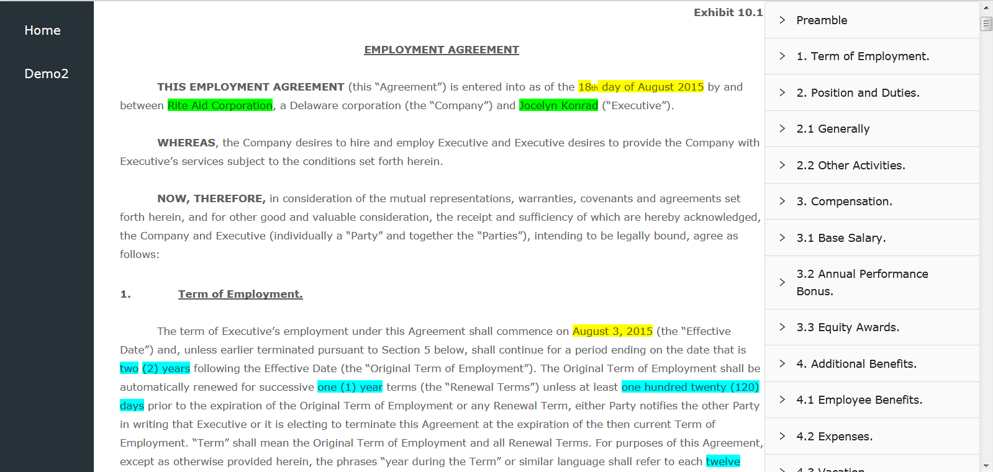
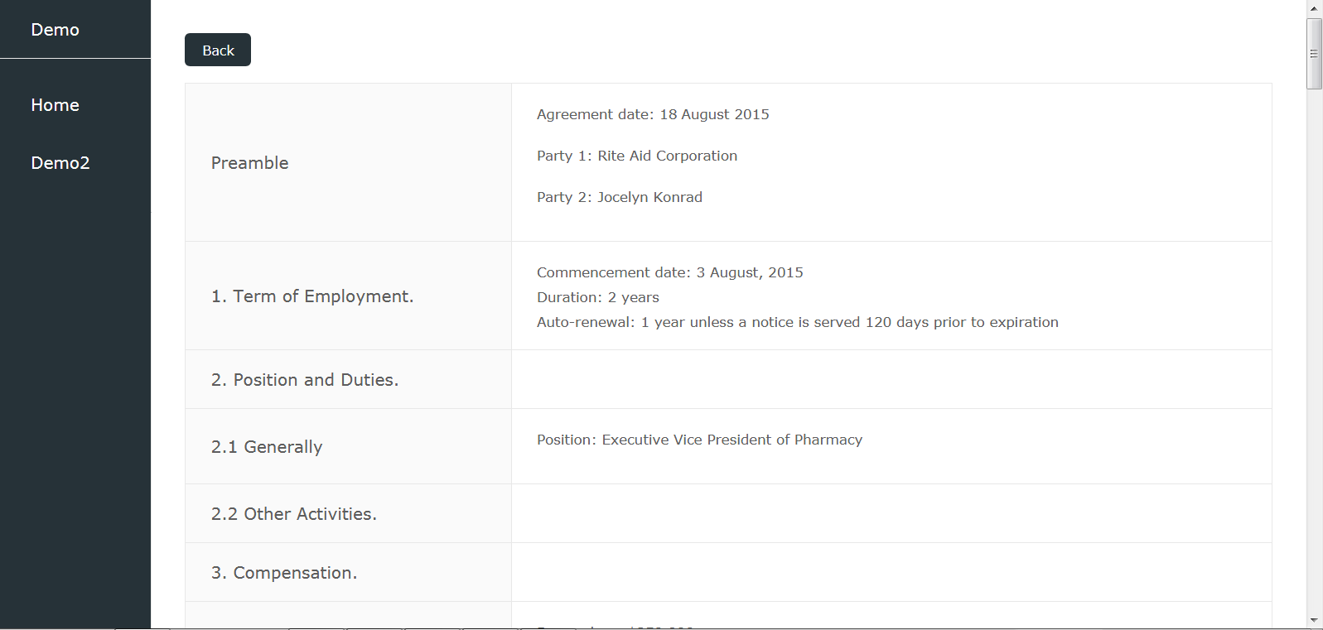
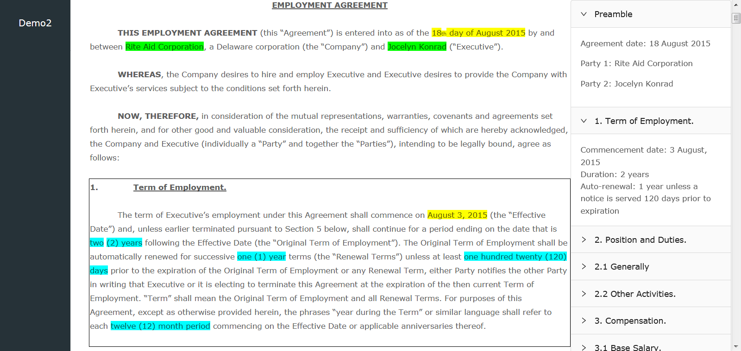
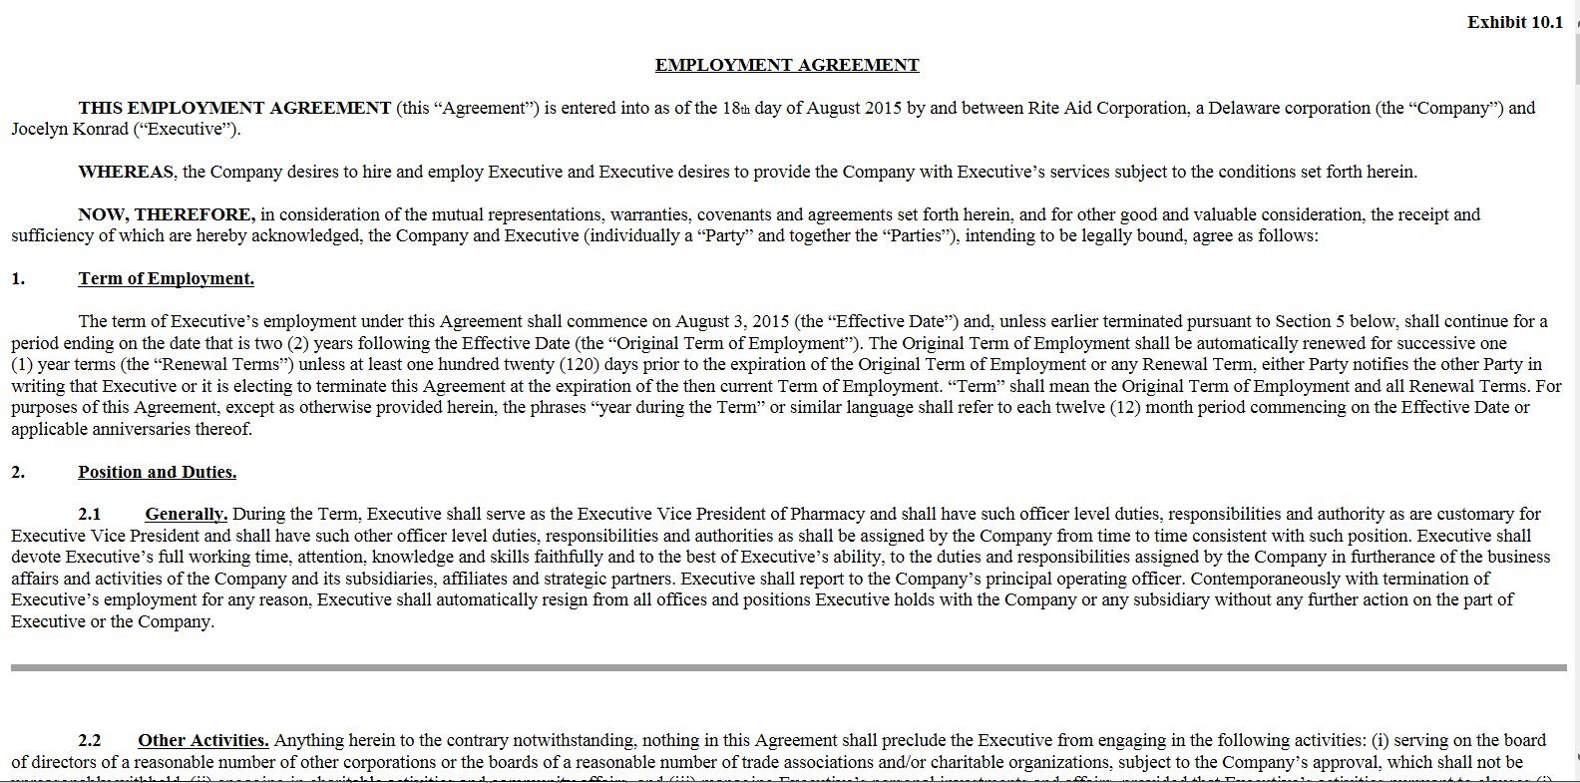
Identify. Summarize. Extract.

Slide 10
End-to-End Enterprise Software
Team Collaboration
Boost boost, transparency
Project Management
Streamline work processes
A.I
Contract Review
Automatically identify, summarize, extract, speeding up review process
Knowledge Management
Enable smart, versatile searches

Slide 11
Competitors
Team Collaboration
Email, Outlook
Project Management
Email, Outlook
A.I
Contract Review
Luminance (US $23M), Kira System (US $50M), ebrevia (US $4.3)
Knowledge Management
Logikcull (US $25M), CsDisco (US $135M)
Notes:
<number>

Slide 12
Competitive Advantage
Technology Immaturity
Product Focus
Business Mistakes
Notes:
<number>

Slide 13
Thank you!

Slide 14
Extra

Slide 15
1
Our Team & Partners

Slide 16

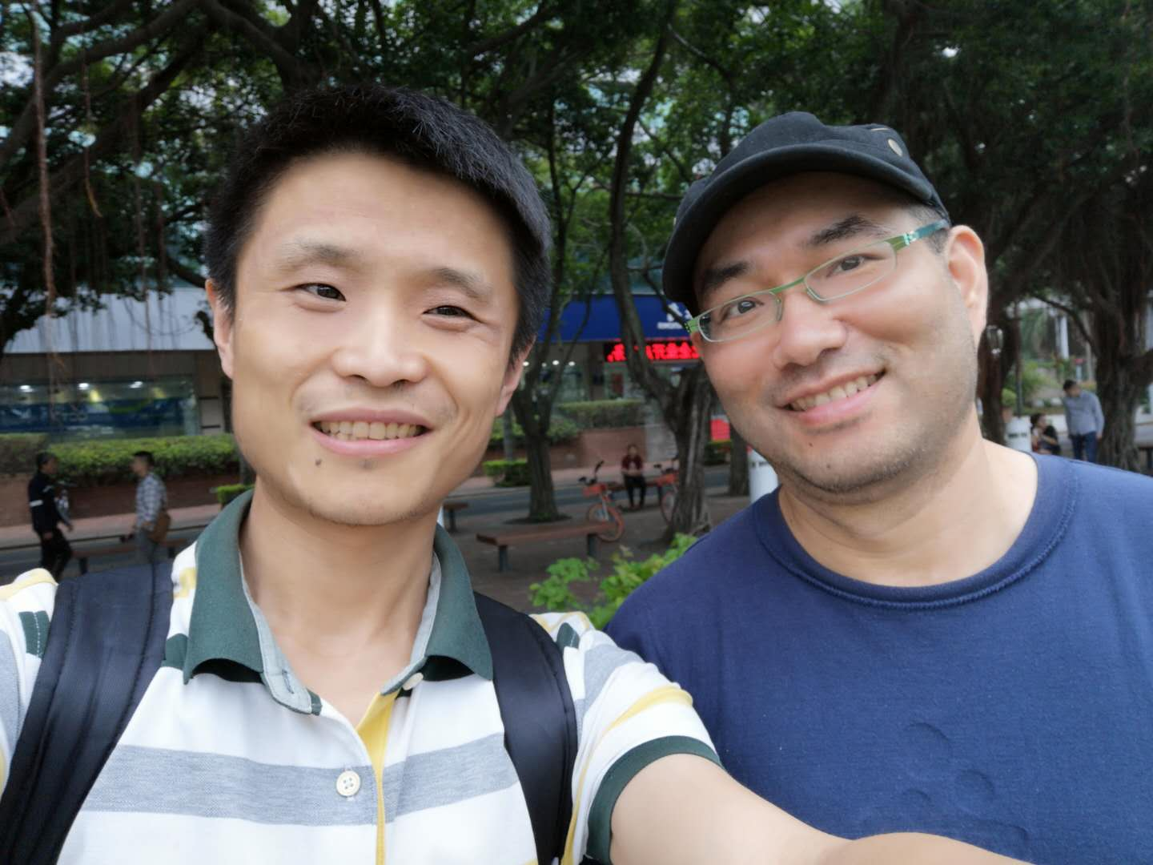
Partners
北京 彩云科技specializes in NLP, translation, weather forecast, etc.
Dr肖达, 清华大学，北京邮电大学 教授, 彩云科技chief scientist One of the few researchers interested in AGI in mainland China We have been discussing AGI for several years
彩云科技has been developing their own BERT-like models since the beginning of BERT
We are now working together on the initial training of Logic BERT
Possible future collaboration in advanced NLP

Slide 17
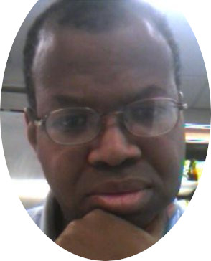
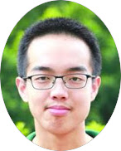
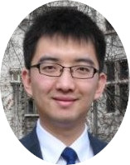
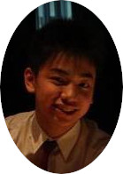
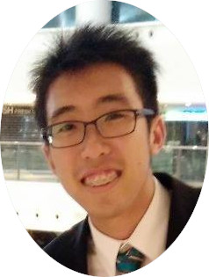
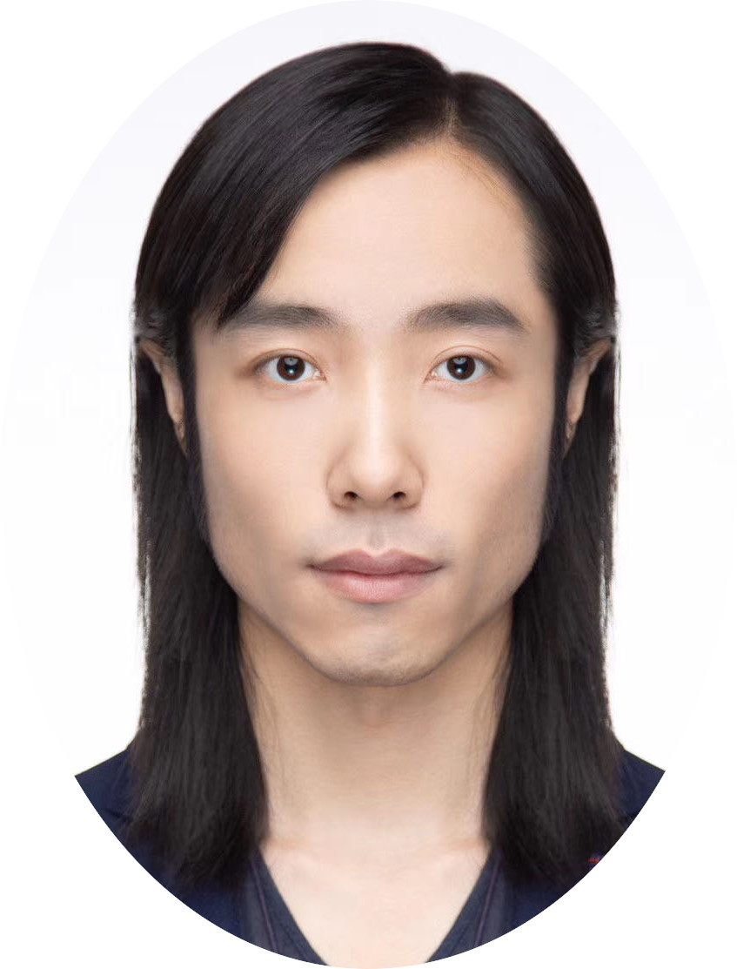

Our Team
(remote member) William H Taylor Binghamton Univ, NY, USA AGI researcher Creative writing
(potential candidate) 陈代超，北大undergrad Long-time friend and researcher interested in AGI
Ben Yu, Univ of Chicago AI entrepreneur, finance, data science
Kaidrian Yu, HK CityU Lawyer, entrepreneur
叶安, 桂林电子科技大学 researcher machine vision, NLP
Pete Tang, CUHK MSc Machine learning Data scientist
Yan King Yin CUHK, Hofstra, NY USA AGI researcher

Slide 18
2
Technology

Slide 19

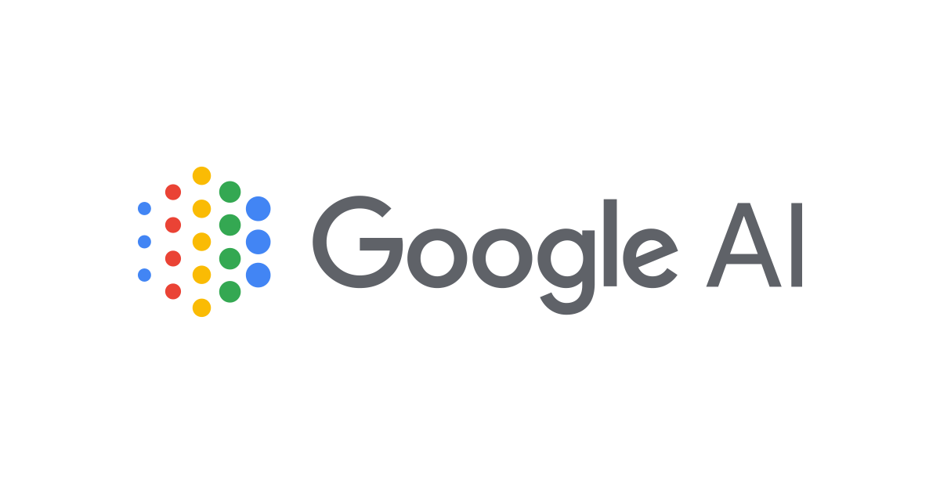

Why now? Why us?
Released 10 months ago
Heelal obtained “Premium” status in “Startup with IBM” program, earning more than US$120,000 IBM cloud credits
Released 9 months ago
Sets record for 11 NLP tasks out of 12
Massively reduced training requirement from 1000+ data points to 100+
We can harness and put together the capabilities of 3rd party algorithms to make a program stronger than any competitors
NOW is the perfect time to gain equal ground as market leader

Slide 20
3
Development Plan

Slide 21




Development Plan
First Stage (Now – 2020 end)
Second Stage (2020 – 2021 Q1)
Third Stage (2021 Q1 onwards)
Legal-BERT development
Development of query-based knowledge graphs
Data treatment and annotation
User interface design
Train ML algorithms on more diverse dataset to suit more use cases
Market testing
Customer acquisition
Continue R&D improvement

